Slide 1


Evaluation of In-Service Field
Performance of High Polymer-Modified Asphalt Concrete Overlays
Jhony Habbouche, Ph.D., P.E.
Senior Research Scientist – Pavements
Virginia Transportation Research Council (VTRC)
2024 Nevada Transportation Conference, Session 3
Tuesday, May 7th, 2024

Slide 2
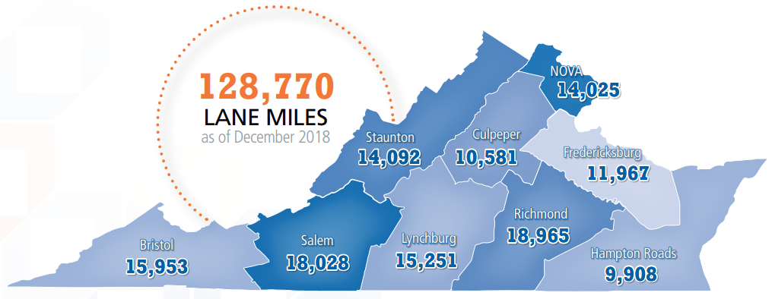

Introduction
Virginia’s Network
3rd largest US public roadway network
Interstates: > 1,000 of 5,000 lane-miles of asphalt over jointed concrete pavement (JCP)
Primary network: > 1,100 of 22,000 lanes-miles of asphalt over JCP

Slide 3
Introduction
High Polymer Modified Asphalt (HP) Mixtures
HP mixtures may offer additional advantages in flexible pavements subjected to heavy & slow moving traffic loads.
  New Construction: Consideration to fatigue cracking, rutting & shoving in AC layer, total rutting, and top-down cracking
  Rehabilitation (AC Overlay): Consideration to Reflective Cracking

Slide 4
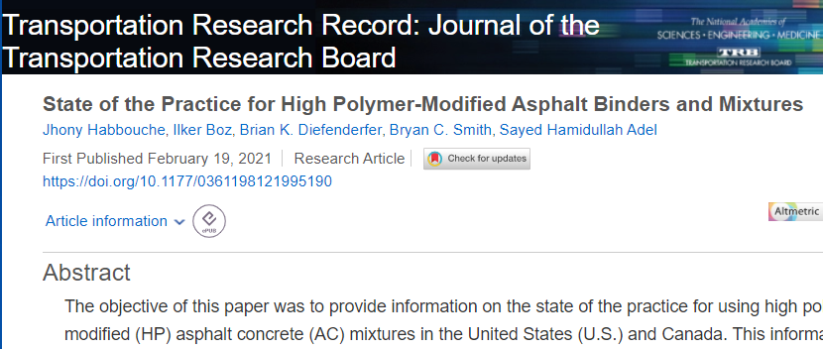

Background
State-of-the-Practice

Slide 5
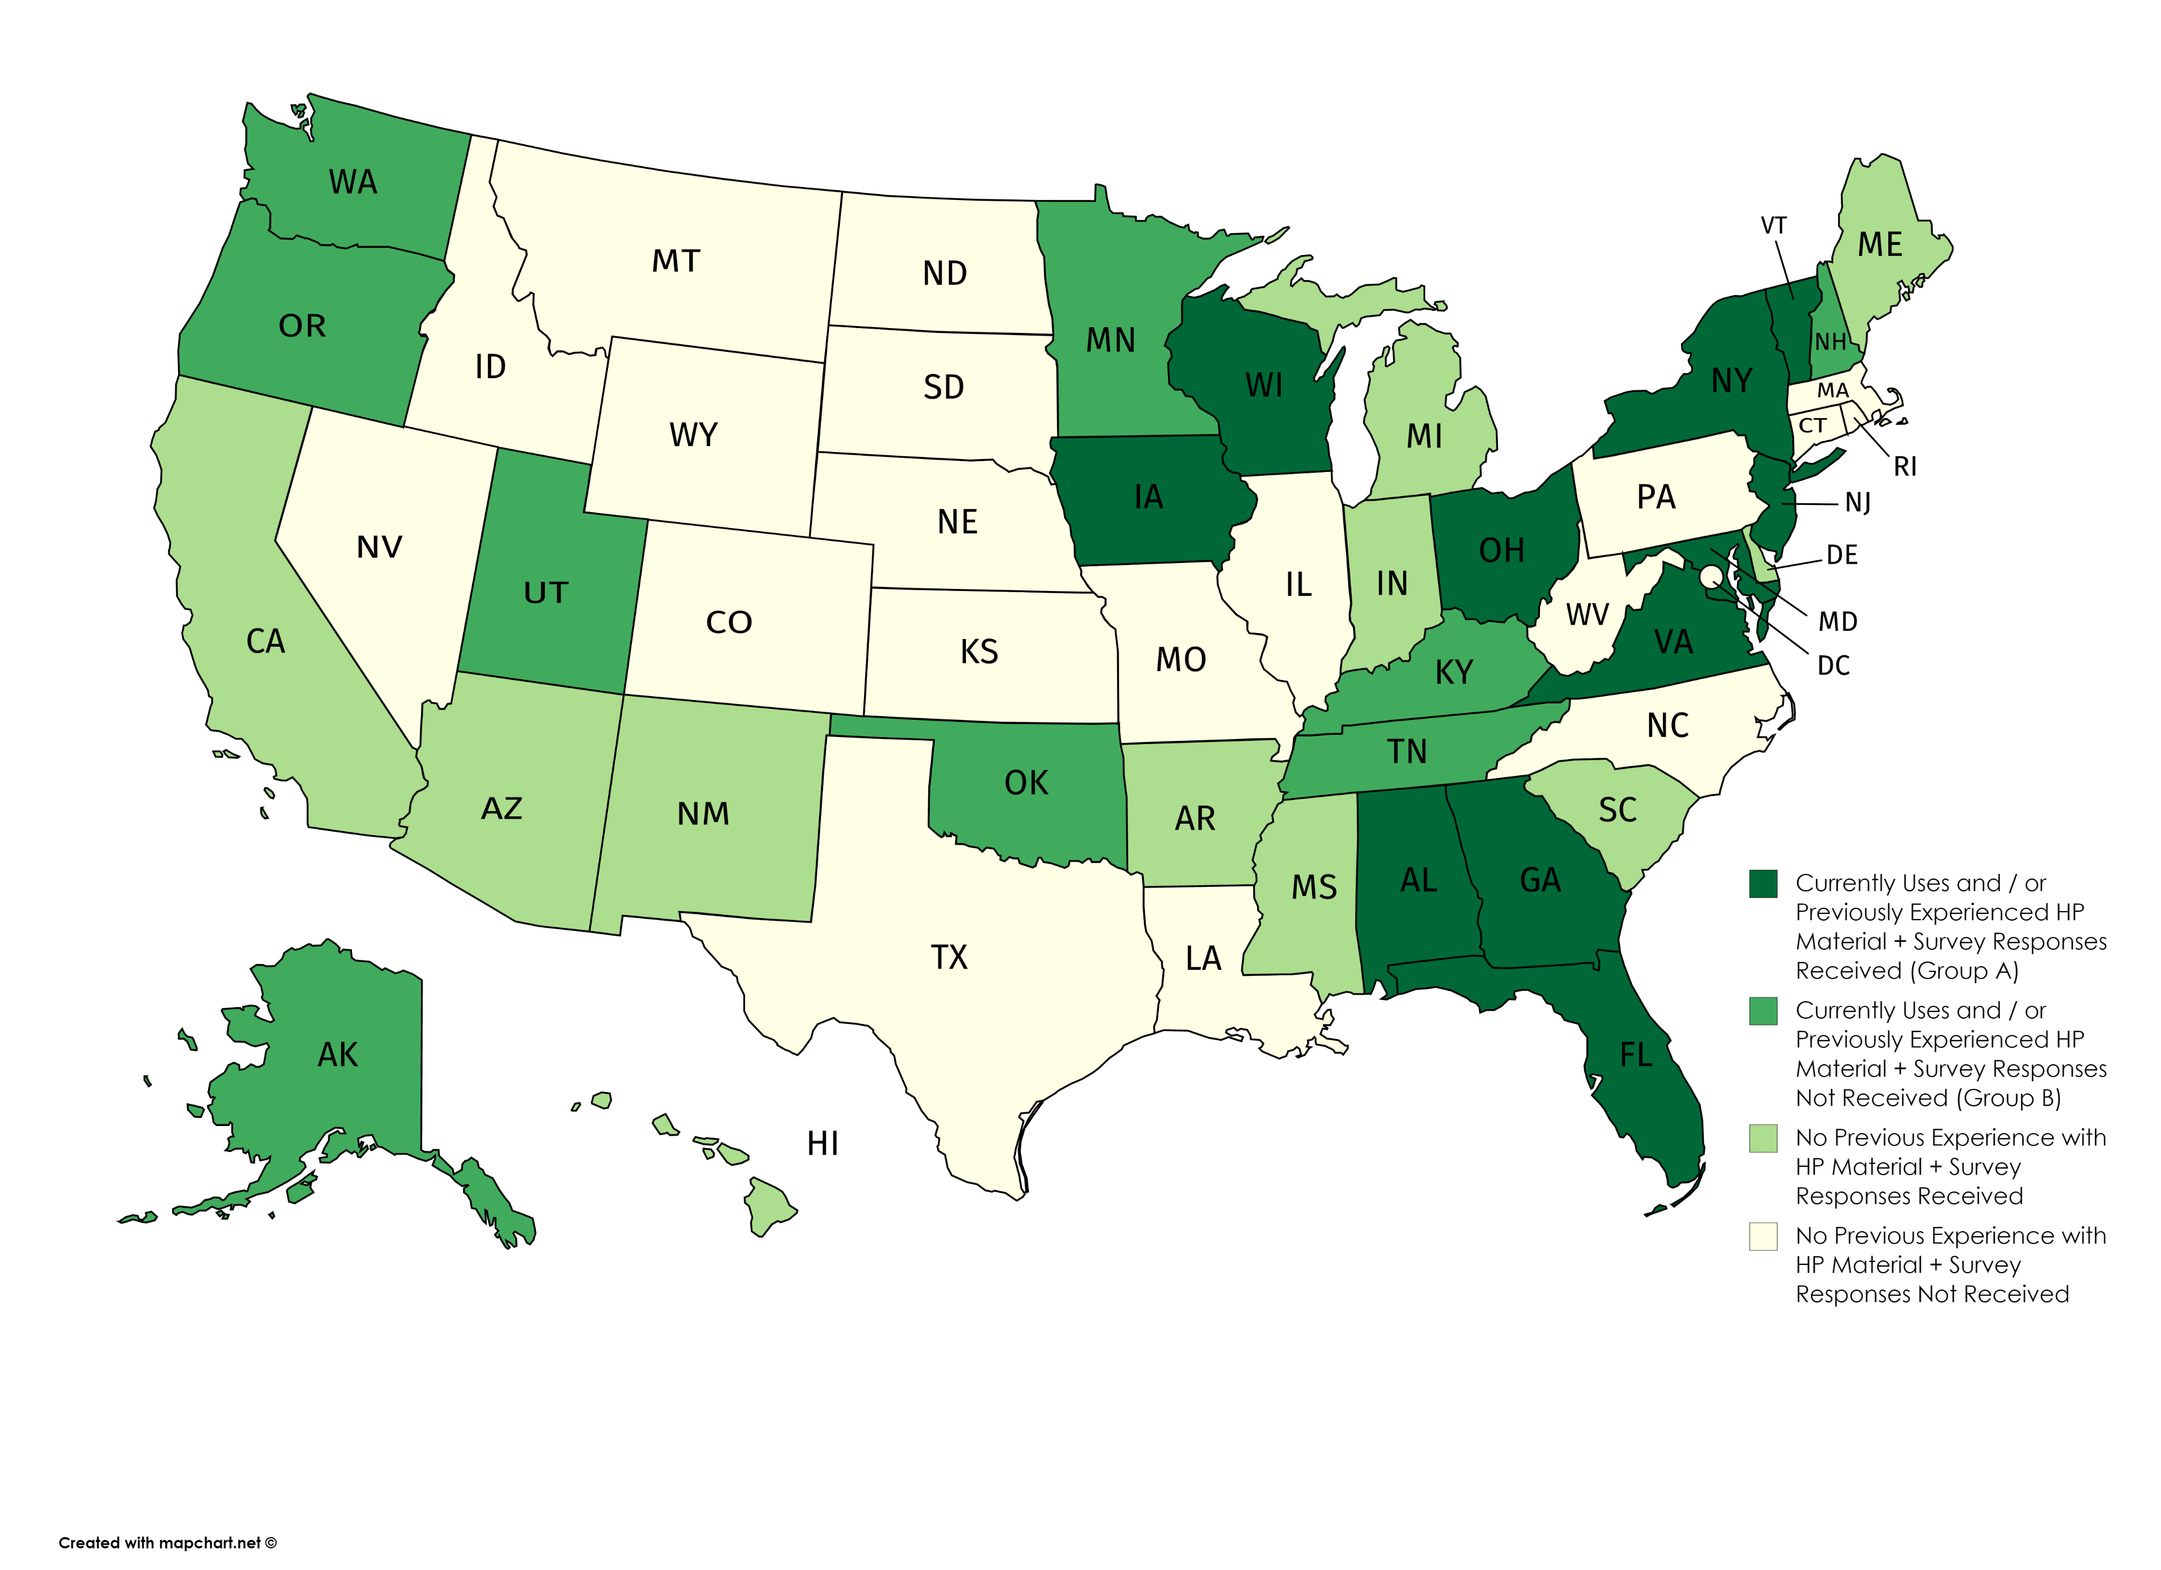
State-of-the-Practice
Survey of US Transportation Agencies
Currently uses and/or previously experienced HP
material + Survey Responses Received
Currently uses and/or previously experienced HP
material + Survey Responses Not Received
No previous experience with HP material +
Survey Responses Received
No available literature on previous experience with HP material + Survey Responses Not Received

Slide 6
State-of-the-Practice
Lessons Learned and Best Practices
The technical help provided by the polymer supplier was very beneficial; the contractors learned a lot about how to handle and store the HP binder.
It is recommended that the contractors have other options if tank storage time becomes an issue, such as using HP binders in other applications or blend down options.
It is recommended that HP AC mixtures be kept out of low production or handwork areas unless absolutely necessary.
A material transfer device must be used to help contractors better establish a continuous paving process to produce a higher quality and smoother mat.

Slide 7
State-of-the-Practice
Lessons Learned and Best Practices
The in-line pipe diameters at the mix plant should be checked prior to delivery of HP asphalt binders; if needed, larger pipe diameters must be used.
Wax-like products, typically used to reduce binder viscosity, are not recommended.
Communication between the mix plant personnel and the supplier of the binder is considered essential to ensure there is no delay in production given the tendency of the HP asphalt binder to thicken quickly.
The quality of HP binder after delivery to the contractor should always be checked with respect to required specifications.

Slide 8
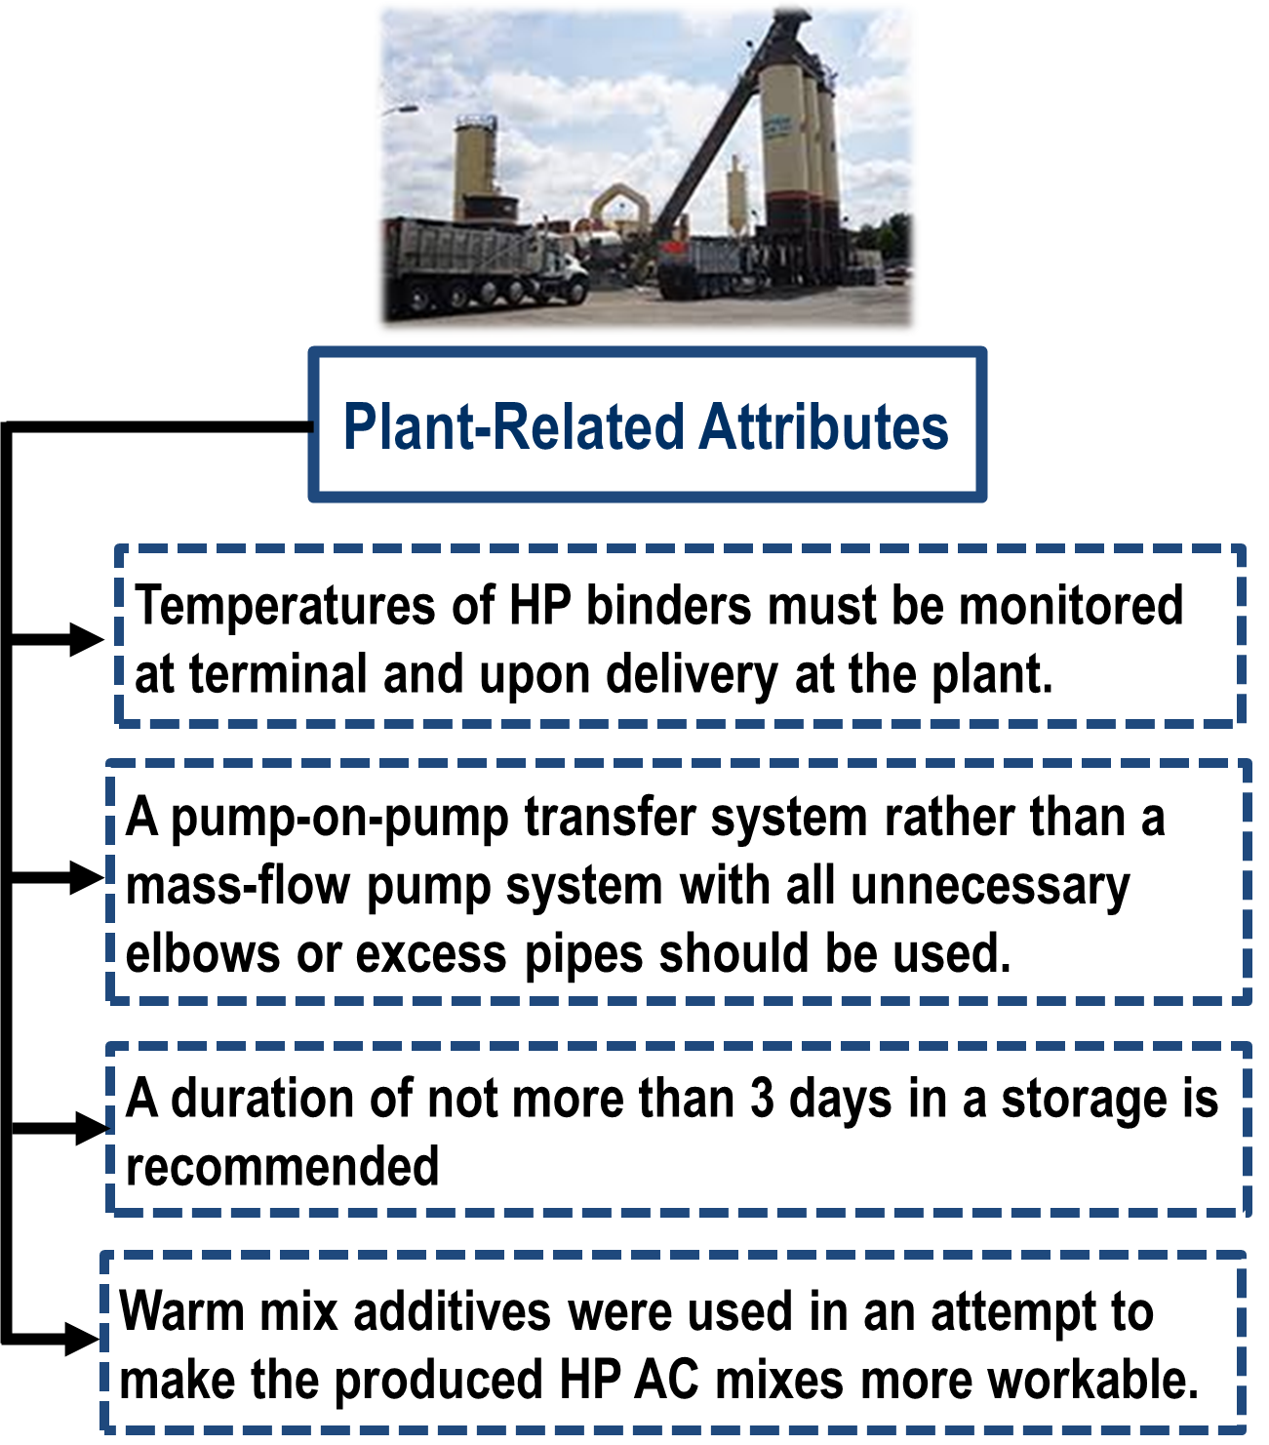
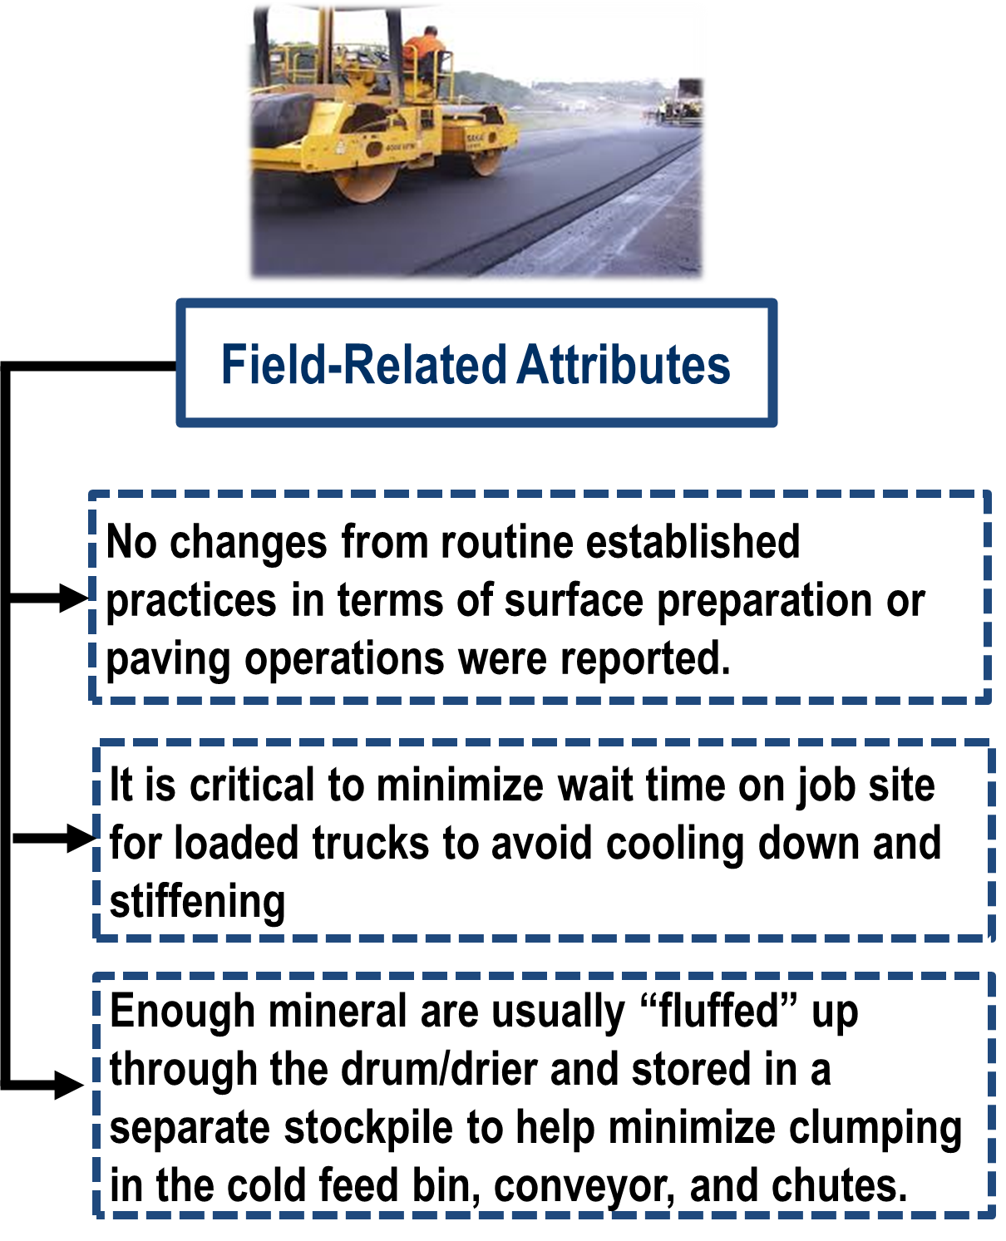
State-of-the-Practice
Construction Practices: Experience of VA Contractors

Slide 9
Background
Definition and Specifications
Definition and acceptance of HP binders is not related to SBS polymer content.
Performance-oriented viewpoint: definition related to specific binder rheology-related parameters and characteristics.
Agency | Standard / Test Method | Properties / Comments
Nevada | AASHTO T 315 AASHTO T 350 Nev. T746F | PG 70-34NV J_{nr, 3.2} ≤ 0.1 kPa⁻¹ and R_{3.2} ≥ 90% at 70ºC Original ductility at 4ºC, 5cm/mm ≥ 20 cm PAV-aged G*sinδ ≤ 4,000 kPa
Virginia | AASHTO T 332 AASHTO T 350 | PG 76E-28 J_{nr, 3.2} ≤ 0.1 kPa⁻¹ and R_{3.2} ≥ 90% at 76ºC

Slide 10
Background
HP AC Mixtures in Virginia: Types & Quantities
Year | Comments: Mix Type / District | Quantity of HP AC Mixes Produced (tons)
 |  | Specific per Mix Type & District | Total
2014 | SM-9.5 / NOVA (trial section) | -- | --
2015 | SM-9.0 / NOVA | 4,808 | 44,084
 | SM-12.5 / NOVA | 31,972
 | SMA-9.5 / NOVA | 7,304
2016 | SM-12.5 / NOVA | 5,643 | 11,848
 | SMA-9.5 / Richmond | 6,205
2017 | SM-12.5 / Hampton Roads | 11,726 | 69,744
 | SMA-12.5 / Hampton Roads | 24,005
 | SM-9.5 / NOVA | 3,904
 | SM-12.5 / NOVA | 25,954
 | SM-12.5 / Richmond | 4,155
2018 | SM-9.5 / NOVA | 974 | 12,635
 | SM-12.5 / NOVA | 11,661
2019 | SM-9.0 / NOVA | 17,724 | 65,923
 | SM-9.5 / NOVA | 6,598
 | SMA-9.5 / NOVA | 41,601

Slide 11
Objective & Scope of Work
Assess the viability of using HP AC mixtures in Virginia as a reflective cracking mitigation technique or as a tool for increased crack resistance on higher volume facilities:
Providing information on the state of practice in Northern America
Evaluating the performance characteristics of PMA and HP plant produced mixtures placed in Virginia
Compiling and analyzing PMS data for relevant in-service HP and several PMA pavements in Virginia
Determining the life expectancy of HP AC overlays

Slide 12
In-Service Field Performance
HP and PMA Selected Routes
No. | Route | County / County Mileposts | Pavement Type | Activity |  | Year of Prior Rehabilitation
 |  |  |  | Details | Year
1 | I-95SB | Prince William, 0.02-3.89 | BOJ | SM-12.5 E(HP) 2.0 in | 2015 | 2009
2 | I-95SB | Prince William, 10.98-13.12 | BOJ | SMA-9.5 E(HP) 1.5 in SMA-9.0 E(HP) 1.0 in | 2015 | 2007
3 | I-95NB | Prince William, 0.07-3.92 | BOJ | SM-12.5 E(HP) 2.0 in | 2015 | 2008
4 | I-495NB | Fairfax, 5.56-6.63 | BOJ | SM-12.5 E(HP) 2.0 in | 2016 | 2012
5 | I-95SB | Hanover, 2.76-5.63 | BOJ | SMA-19.0 E 2.0 in SMA-12.5 E(HP) 1.5 in | 2016 | 2002
C6 | I-95NB | Henrico, 7.33-9.55 | BOJ | SMA-9.5 E 1.5 in SMA-19.0 E 2.0 in | 2015 | 2004
7 | I-64EB | York, 14.81-20.55 | BOJ | THMACO 0.75 in SMA-12.5 E(HP) 2.0 in | 2017 | New Construction
8 | I-64WB | York, 14.98-20.33 | BOJ | THMACO 0.75 in SMA-12.5 E(HP) 2.0 in | 2017 | New Construction
9 | I-95NB | Fairfax, 3.41-4.45 | BIT | SM-12.5 E(HP) 2.0 in | 2017 | 2010
10 | I-495NB | Fairfax, 1.194-3.66 | BOJ | SM-9.0 E(HP) 1.0 in SMA-9.5 E(HP) 1.5 in | 2018 | 2014
11 | I-95NB | Prince William, 11.121-12.64 | BOJ | SM-12.5 E(HP) 2.0 in | 2018 | 2011

Slide 13
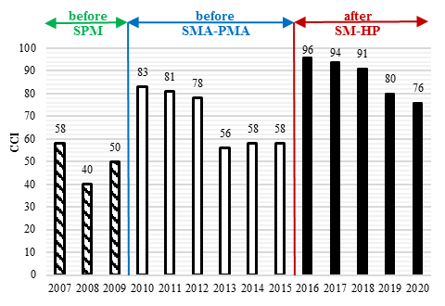
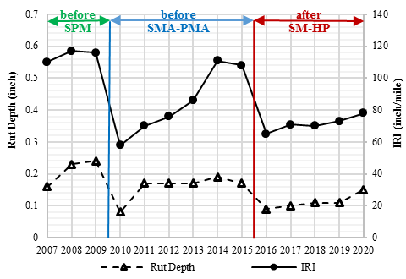
In-Service Field Performance
BOJ Section No.1

Slide 14
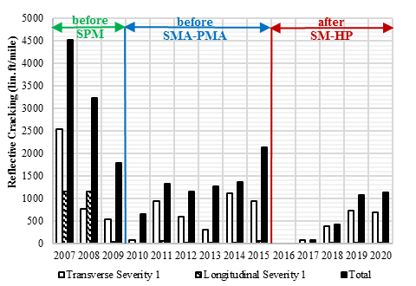
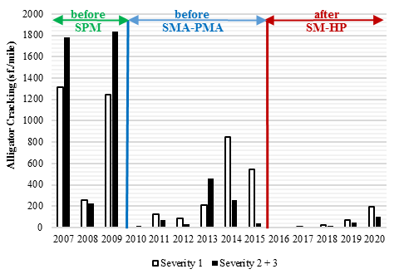
In-Service Field Performance
BOJ Section No.1, Cont’d

Slide 15
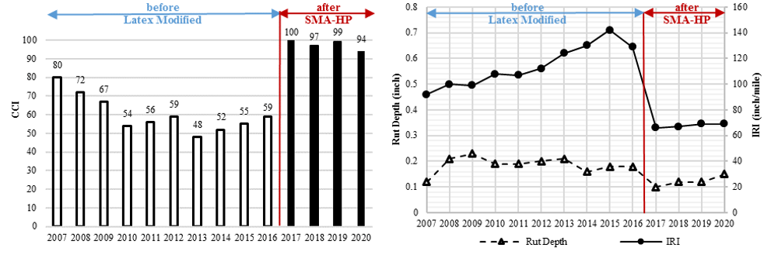
In-Service Field Performance
BOJ Section No.2

Slide 16
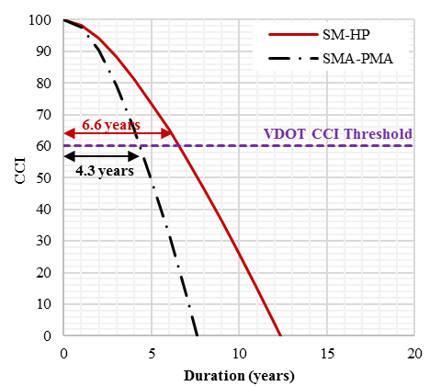
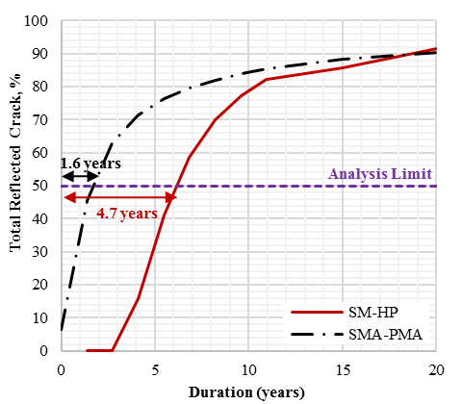
In-Service Performance Life
Analysis (i), BOJ Section No.1

Slide 17
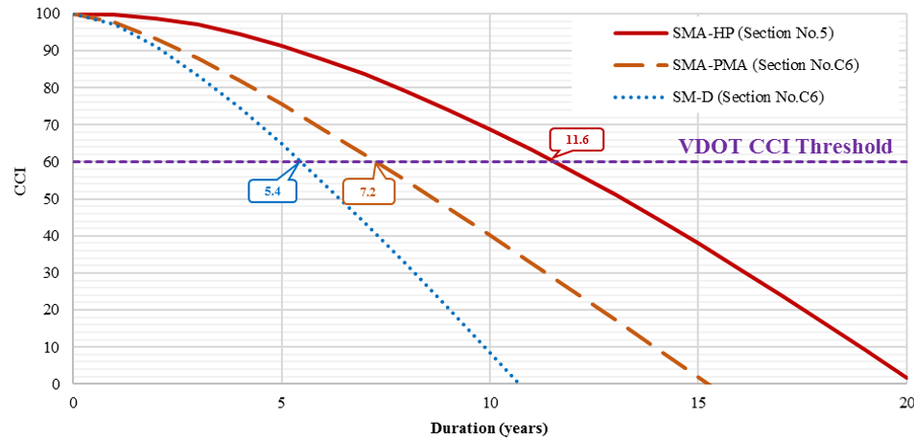
In-Service Performance Life
Analysis (i), BOJ Section No.5 & C6, Approach I

Slide 18
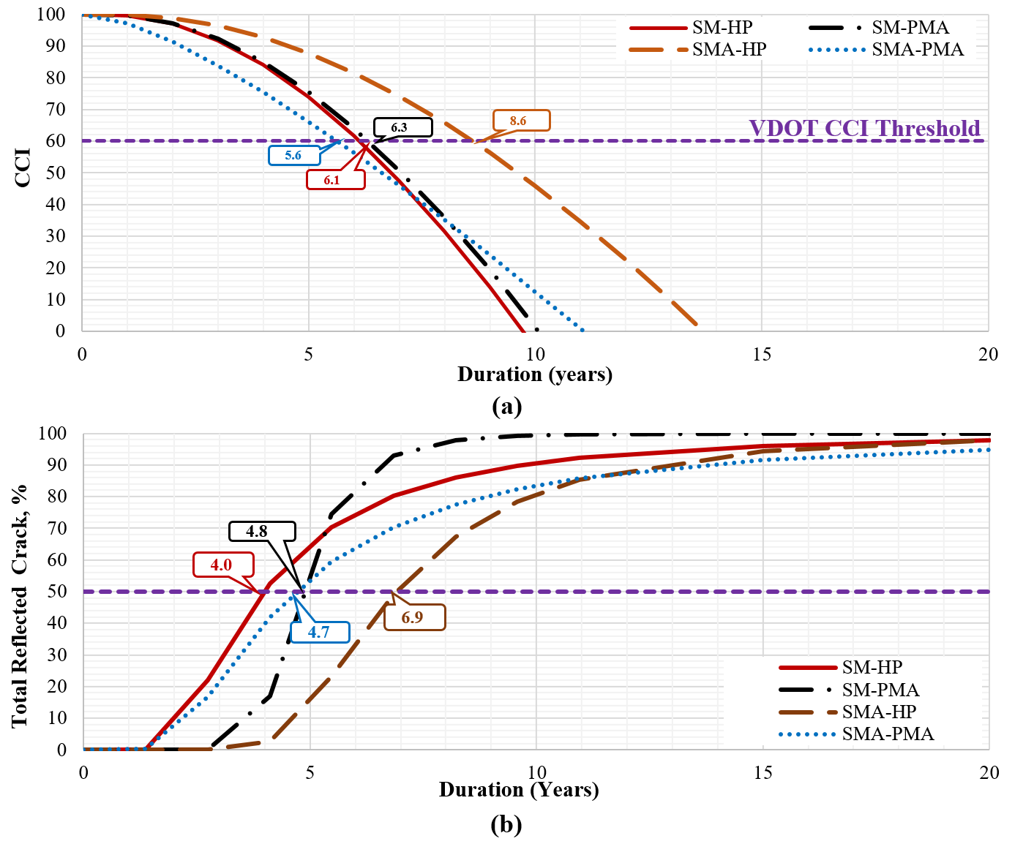
In-Service Performance Life
Analysis (ii), Approach I
SM-PMA vs. SM-HP vs. SMA-PMA vs. SMA-HP

Slide 19
In-Service Performance Life
Analysis (ii), Approach II
SM-PMA vs. SM-HP vs. SMA-PMA vs. SMA-HP

Slide 20
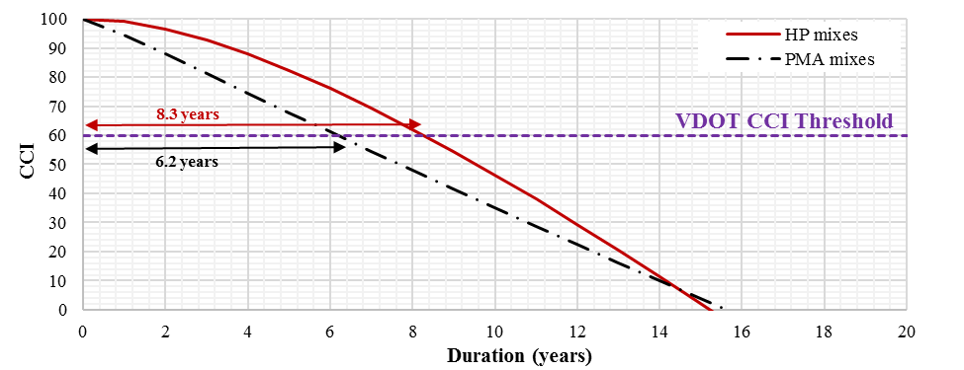
In-Service Performance Life
Analysis (iii), Approach I
PMA vs. HP AC Mixtures

Slide 21
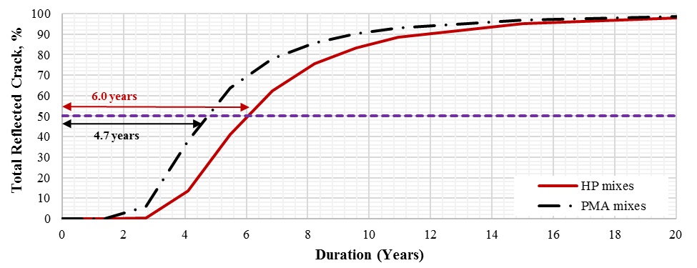
In-Service Performance Life
Analysis (iii), Approach II
PMA vs. HP AC Mixtures

Slide 22
Summary of Findings & Conclusions
According to the PMS distress data, all of the evaluated mixtures (HP or PMA) had some degree of reflective cracking.
CCI values were higher and CCI loss rates were lower during the service life of HP overlays when compared with the PMA overlays.
Based on the collected and documented PMS data, HP sections showed very promising performance after 5 years (2015-2020) regardless of the traffic level and pre-existing pavement conditions.
The HP and PMA AC overlays had an average predicted service life of 8.3 and 6.2 years (Approach I), and 6.0 and 4.7 years (Approach II), respectively, indicating ~ 34% extension of performance life of the AC overlay with HP modification.

Slide 23



Evaluation of In-Service Performance of Highly Polymer-Modified Asphalt Concrete Overlays
For more information:
Habbouche.jhony@gmail.com

